Slide 1
Data Base System Week 6th Topics
Logical Design
Entity-Relationship Modelling

Slide 2
Data Base System Week 6th Topics
Objectives
How to use Entity–Relationship (ER) modelling in database design.
Basic concepts associated with ER model.
Diagrammatic technique for displaying ER model using Unified Modelling Language (UML)
How to build an ER model from a requirements specification.
Concepts of the ER Model
Entity types
Relationship types
Attributes
Entity
A single event or real world object about which an organization wants to record information i.e. to which values will be assigned
Entity Class \ Set
Group of objects with same properties, identified by enterprise as having an independent existence

Slide 3
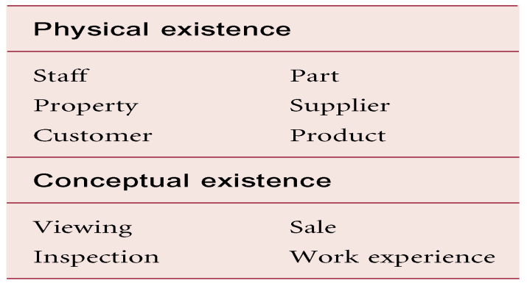
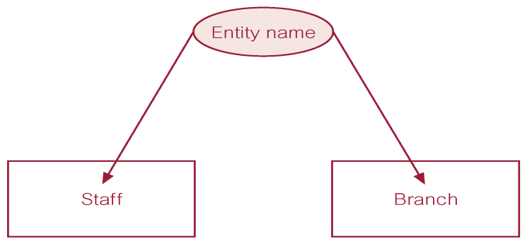
Data Base System Week 6th Topics
Examples of Entity Types
ER Diagram of Staff and Branch Entity Types

Slide 4
Data Base System Week 6th Topics
Attributes
Property of an entity or a relationship type
Attributes Domain
Set of allowable values for one or more attributes
Simple Attribute \ Atomic
Attribute composed of a single component with an independent existence e.g. customer id, RNO
Composite Attribute
Attribute composed of multiple components, each with an independent existence i.e. that can be broken down into sub components e.g. address
Derived Attribute
Attribute that represents a value that is derivable from value of a related attribute, or set of attributes, not necessarily in the same entity type e.g. age i.e. not stored in the DB
Multivalued Attribute
Attribute that holds multiple values for each occurrence of an entity type.
e.g. skills (it’s a problem should be removed)
Stored Attributes
An attribute stored in the DB
Identifier
An attribute that identifies an entity instance among other instances in entity class e.g. Rno or registration number in student

Slide 5
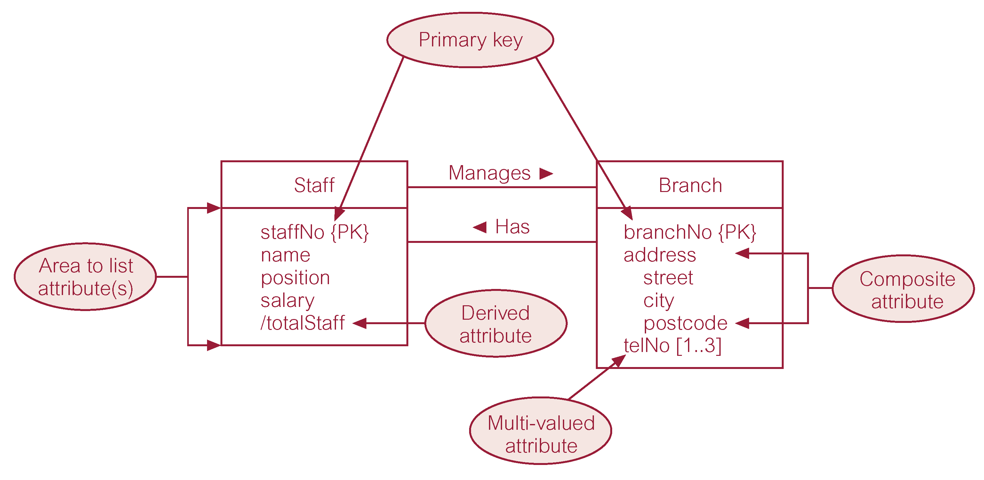
Data Base System Week 6th Topics

Slide 6
Data Base System Week 6th Topics
Entity Type
Strong Entity Type
Entity type that is not existence-dependent on some other entity type.
Weak Entity Type
Entity type that is existence-dependent on some other entity type.
Strong Entity Type called Client and Weak Entity Type called Preference
Associative Entity
Associates the instances of one or more entity types with one another e.g. a scholar gets an award on his research.
Employee
Department
Scholar
Award
Resaerch

Slide 7
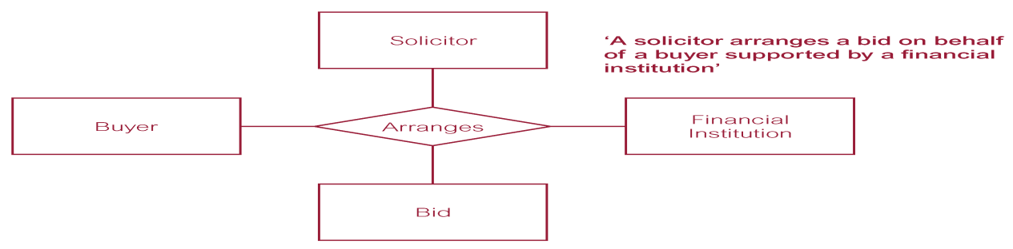
Data Base System Week 6th Topics
Relationship
A logical connection between entities. The entities that participate in the relationship are called participants. The relationship may be between different entities or between an entity or itself.
Degree of a Relationship
Number of participating entities in relationship.
Relationship of degree:
Unary: between the instances of same entity type also called recursive relationship
two is binary;
three is ternary;
four is quaternary.
Employee
Department
Scholar
Award
Research

Slide 8
Data Base System Week 6th Topics
Structural Constraints
Main type of constraint on relationships is called multiplicity.
Multiplicity - number (or range) of possible occurrences of an entity type that may relate to a single occurrence of an associated entity type through a particular relationship.
Represents policies (called business rules) established by user or company.
Cardinality Constraint
The maximum number of relationships are called cardinality
This constraint specify the number of instances of one entity that can be associated with each instance of the other entity.
There are three (3) symbols used to show degree
A Circle means zero. Indicates that relationship is optional
a Line \ stroke (|) means one. Indicates that relationship is mandatory
Crow’s foot symbol means many
The most common degree for relationships is binary.

Slide 9
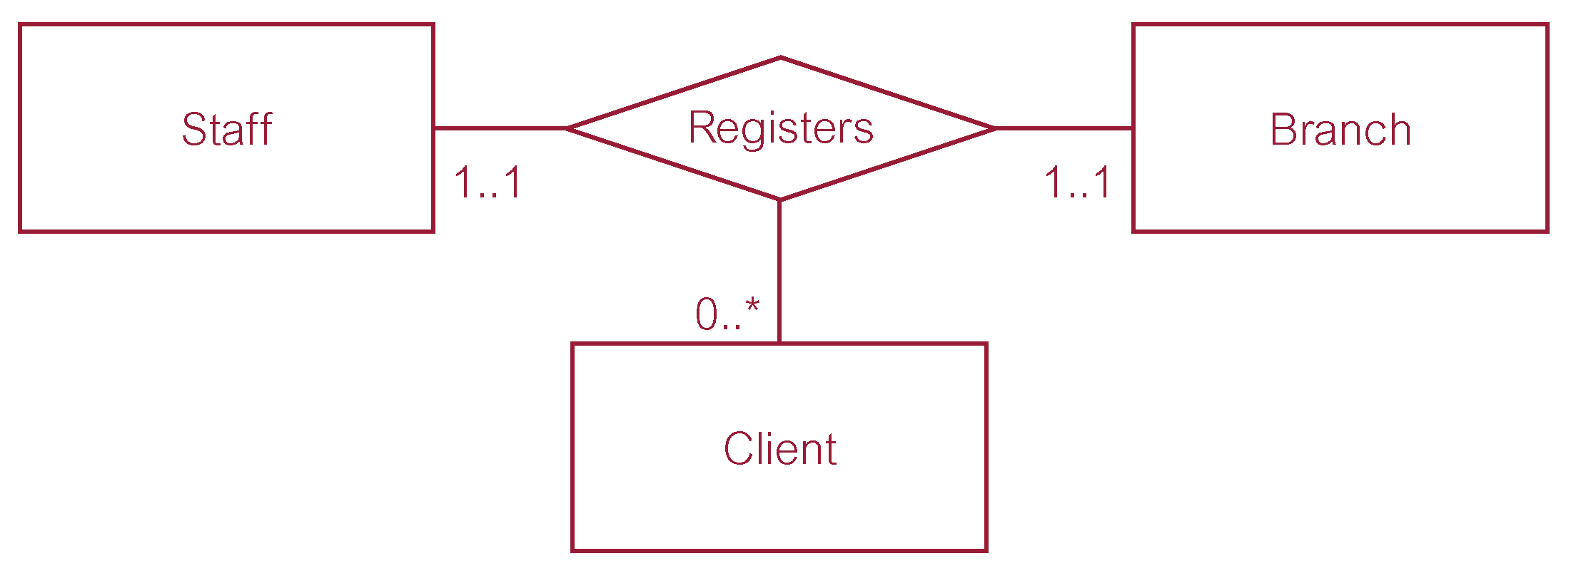
Data Base System Week 6th Topics
Structural Constraints
Binary relationships are generally referred to as being:
one-to-one (1:1)
one-to-many (1:*) ---(Optional)
many-to-many (*:*) ---(Optional)
Many-to-one (Mandatory)

Slide 10
Data Base System Week 6th Topics
Structural Constraints
Examples

Slide 11
Data Base System Week 6th Topics
Subtype and Super type Entities
An entity customer has the attributes (Custid, Address and phone)
For individual: NIC, Profession, Designation
For Organization: RegistrationId, contactperson, Taxid
Generalization is a process identifying more general entity types while specialization is a process identifying more specific entity types

